Slide 1

Feature-Value Optimization for “NewGen” Laptop Pricing
Fundamentals of Programming (PROG8491)
Prof . Raghav Nayyar
Suraj Mishra(8902749)

Slide 2


Introduction
Problem Statement
Overview of Dataset
Data Preprocessing
Exploratory Data Analysis
Feature Engineering
Data Modelling
Price Prediction
Conclusion

Slide 3

INTRODUCTION
NewGen, a rising contender in the laptop market, is well-positioned to transform the business because of its dedication to providing cutting-edge technologies at affordable costs.
Understanding customer preferences and successfully balancing features and pricing in its product offerings are crucial challenges for NewGen as it attempts to appeal to two important demographics: students and creative/working professionals.

Slide 4

PROBLEM STATEMENT
NewGen, a new entrant in the laptop market, seeks to target students and creative/working professionals by offering high-end features at competitive prices.
However, they lack insights into user-valued features and struggle to balance features cost-effectively.
Leveraging a dataset on laptop features, this project aims to identify key features valued by users and optimize their balance for competitive pricing.
Objectives include understanding user preferences and developing a price prediction model.
Results will inform NewGen's product development and pricing strategy.

Slide 5
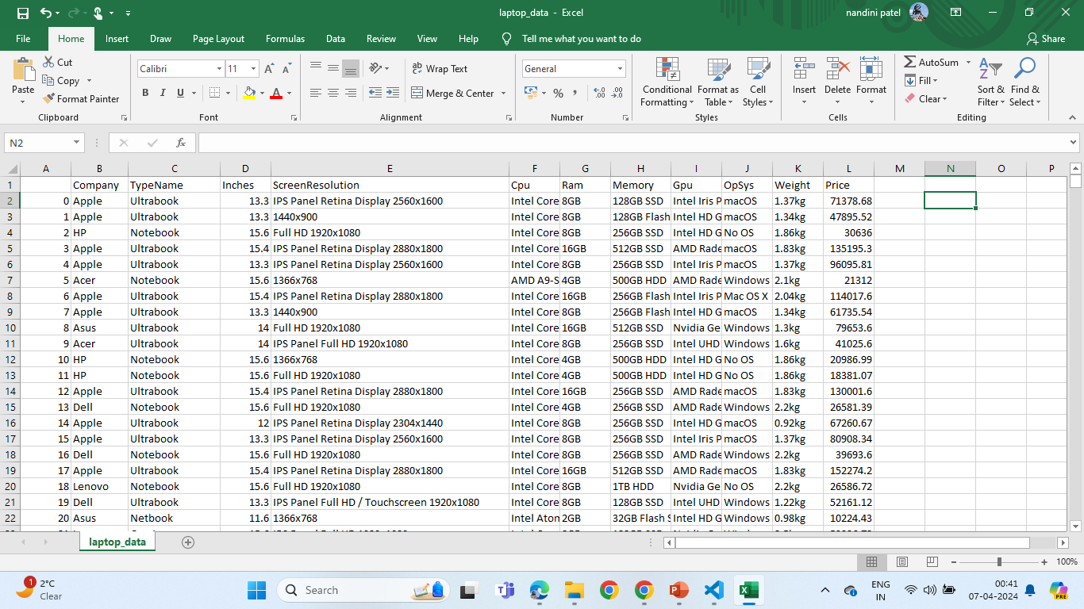
OVERVIEW OF DATASET
Most of the columns in the dataset are noisy and contain a lot of information. However, with the feature engineering/feature selection, will try to uncover the essential features with better results.

Slide 6
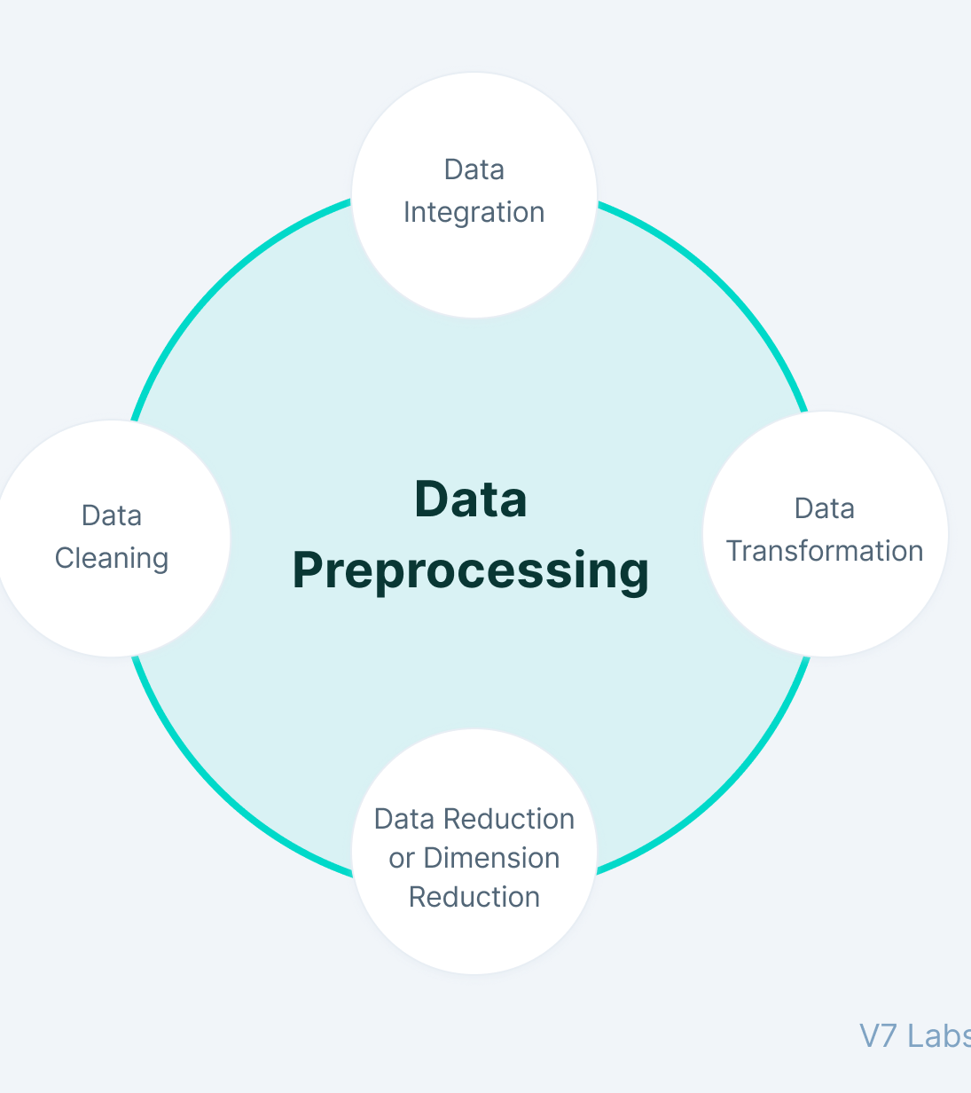
DATA PREPROCESSING
Data Collection:
We collected a dataset containing various features of laptops, including company, type, screen size, RAM, weight, processor, storage, CPU, operating system, and price.
Data Preprocessing:
Cleaned the dataset by handling missing values, converting currency, and standardizing feature formats.
Performed exploratory data analysis (EDA) to gain insights into feature distributions and correlations.
Engineered new features like Touchscreen, IPS display, CPU brand, storage types (HDD, SSD), GPU brand, and operating system categories.

Slide 7
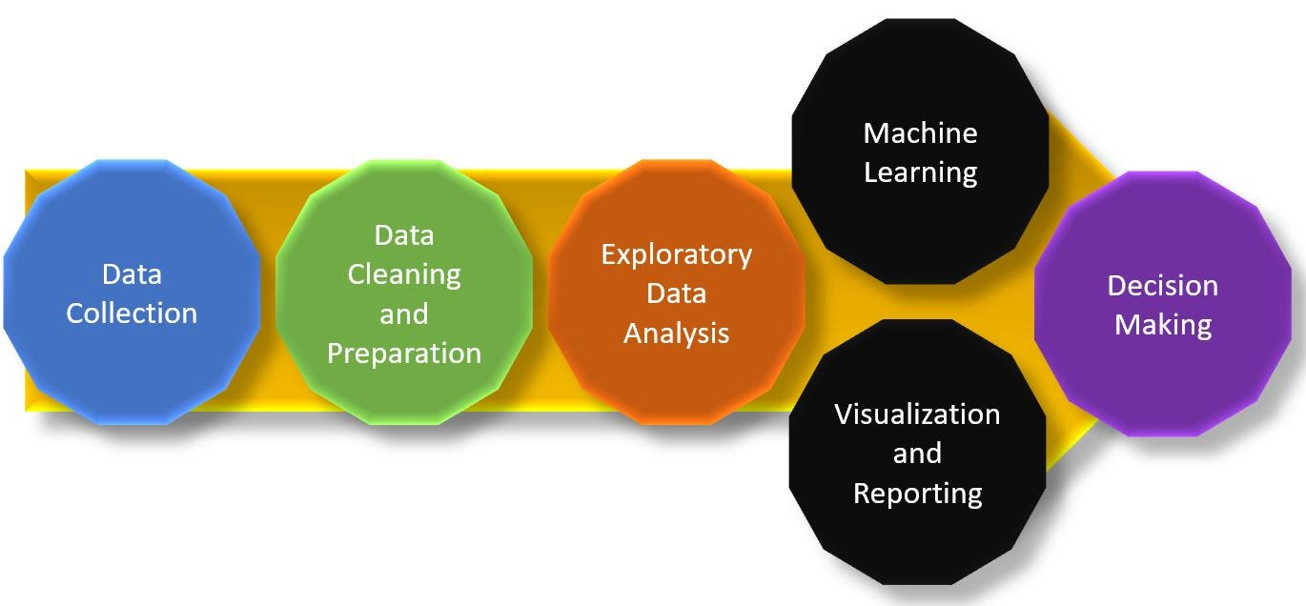
EXPLORATORY DATA ANALYSIS
EDA helps to perform hypothesis testing. Starting from the first column, exploring each column, and understanding what impact it creates on the target column.
Performed preprocessing and feature engineering at the required steps, aiming to perform in-depth EDA to prepare and clean data for better machine learning modeling to achieve high performance and generalize models.

Slide 8
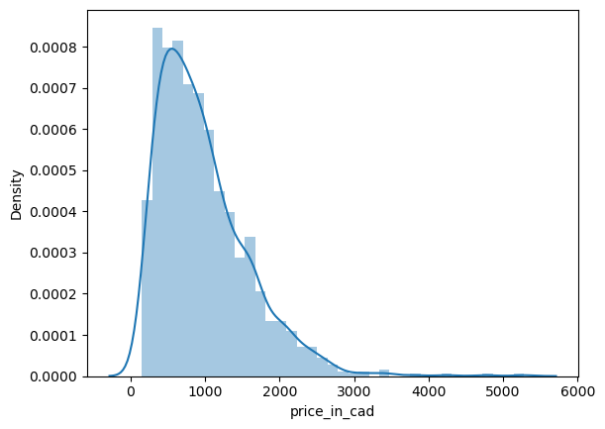
PRICE DISPERSION
Working with regression problem statement target column distribution is important to understand.
The distribution of the target variable is left skewed, and it is obvious that commodities with low prices are sold and purchased more than the branded ones.

Slide 9
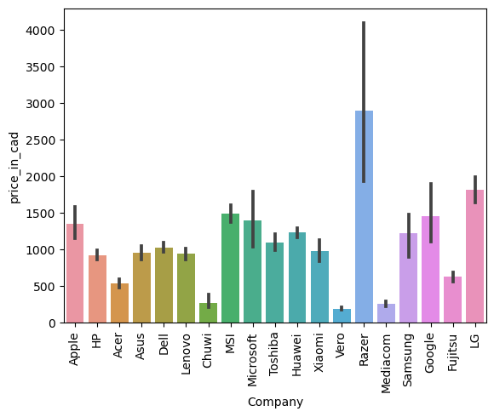
COMPANY MONIKER
We want to understand how does brand name impacts the laptop price or what is the average price of each laptop brand. If we plot a frequency plot of a company then the major categories present are Lenovo, Dell, HP, Asus, etc.
If we plot the company’s relationship with price, then you can observe how prices vary with different brands.

Slide 10
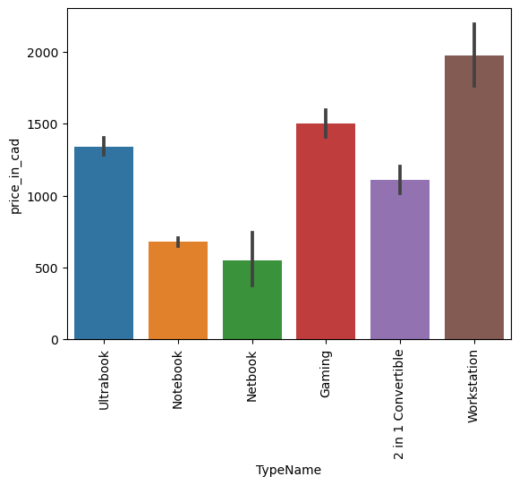
LAPTOP GENRES
Which type of laptop you are looking for like a gaming, workstation, or notebook.
Many people refer notebook because it is under the budget range and the same can be concluded from our data.

Slide 11
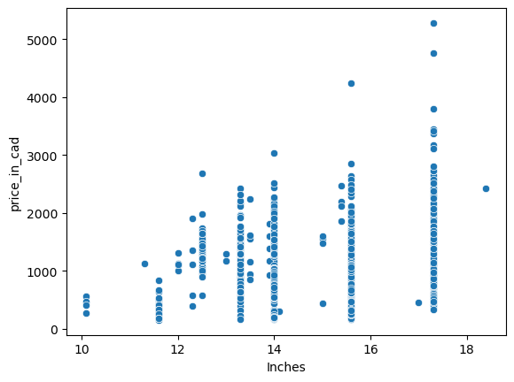
Price Variability Across Laptop Sizes: A Comparative Analysis
A scatter plot is used when both the columns are numerical, and it answers our question in a better way.
From the plot we can conclude that there is a relationship between price and size.

Slide 12
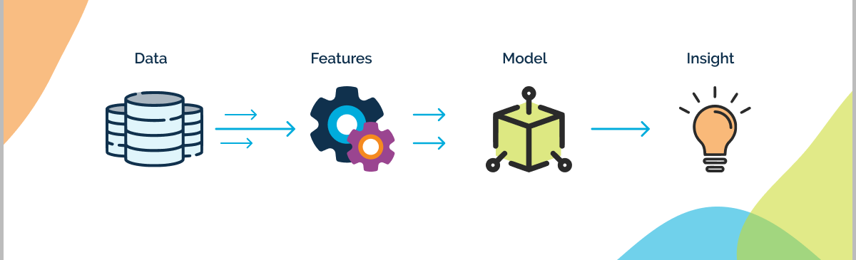
FEATURE ENGINEERING LAPTOP PRICE PREDICTION MODEL
Feature engineering is a process to convert raw data to meaningful information.
Many methods come under feature engineering like transformation, One Hot encoding, etc.

Slide 13
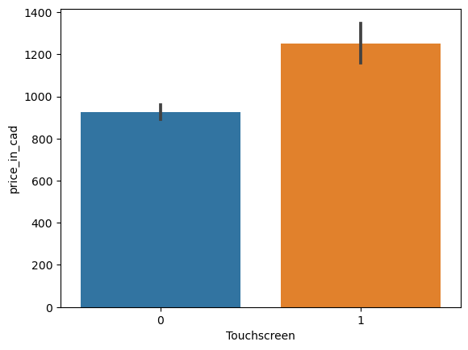
SCREEN RESOLUTION
Screen resolution contains lots of information. Before any analysis, we need to perform feature engineering on it. We have shown below with the help of a bar graph how screen resolution has an impact on price.
IPS Panel
Touchscreen

Slide 14
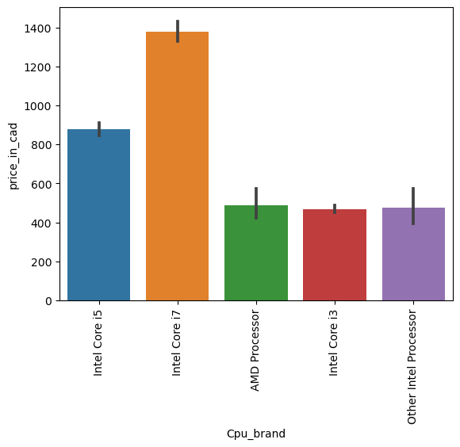
CPU
Based on the bar graph, it's evident that laptops featuring an i7 processor command a higher price compared to those with i5, i3, and AMD processors within a similar price range.
Therefore, the price variation is closely tied to the processor type.

Slide 15
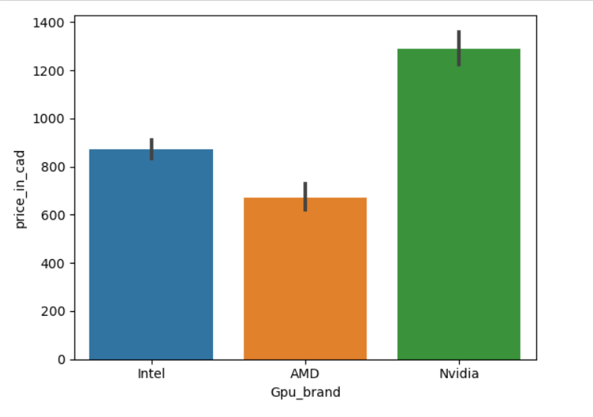
GPU
GPU(Graphical Processing Unit) has many categories in data.
We have which brand of graphic card is there on a laptop, but we do not have how many capacities graphic card is present. So, we will simply extract the name of the brand.

Slide 16
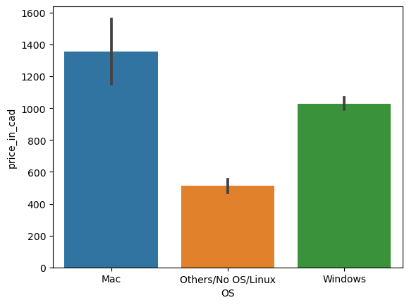
OPERATING SYSTEM
There are many categories of operating systems. We kept all the Windows categories in one, Mac in one, and remaining in others.
When we plot the price against the operating system then, as usual, Mac is the most expensive.

Slide 17
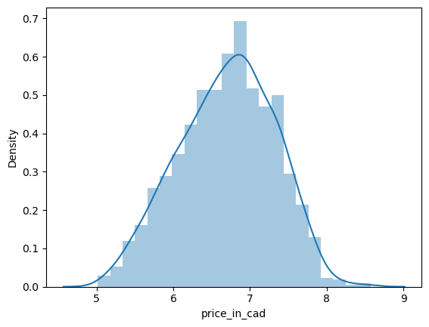
LOG-NORMAL DISTRIBUTION
To augment the model's accuracy, we have presented the log-normal distribution of prices herein.

Slide 18
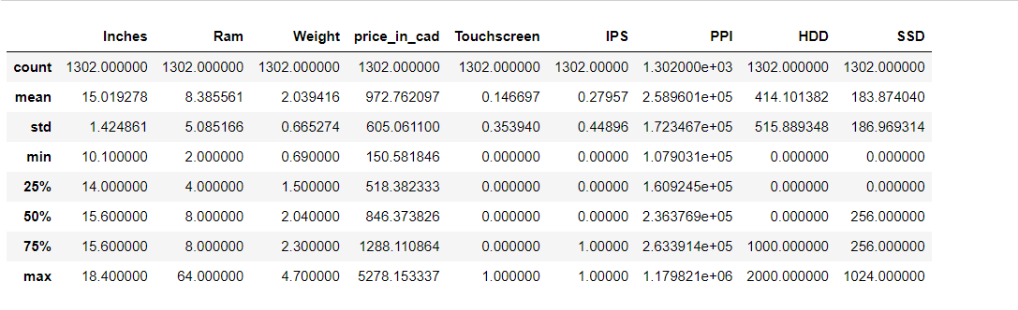
Descriptive Statistics of the dataset

Slide 19
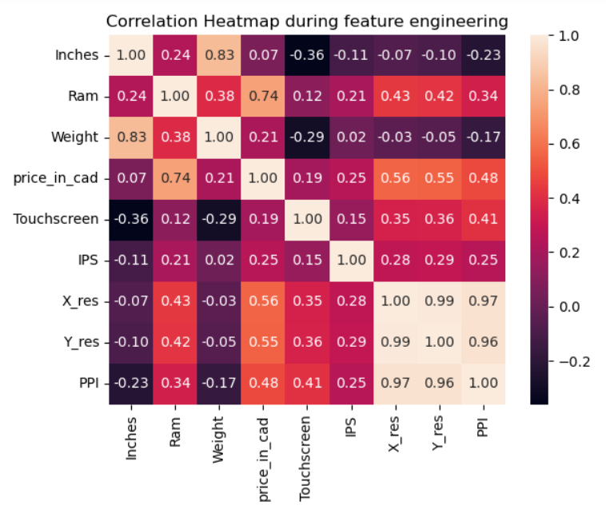
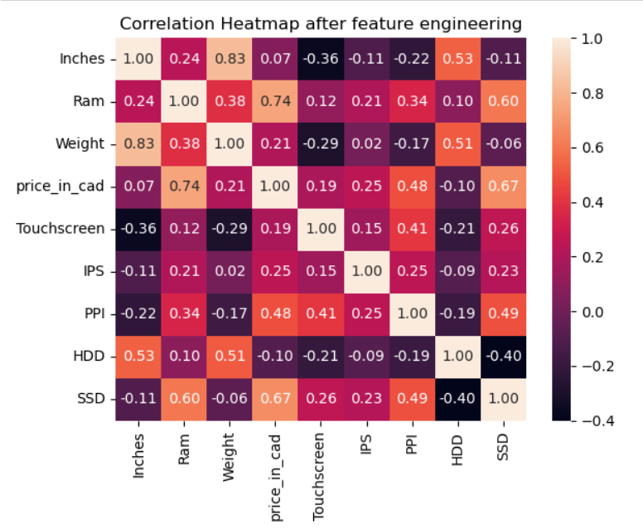
CORRELATION ANALYSIS

Slide 20

Modelling
Linear Regression
Ridge Regression (Using Tuning Hyperparameter)
Random Forest

Slide 21
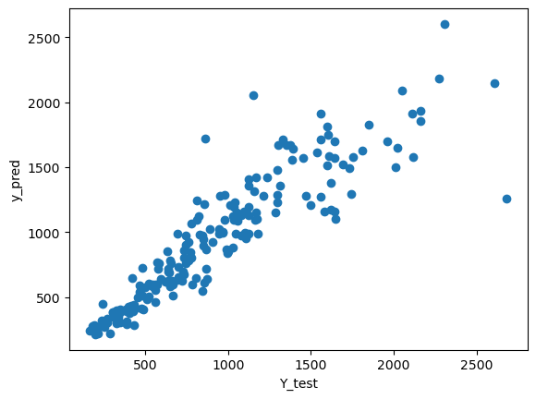
MODEL PREDICTION
As we have gone through various models above, the random forest model’s accuracy is 82%.

Slide 22

PRICE PREDICTION FOR NewGen LAPTOP
Based on the analysis of the existing laptop dataset for NewGen company, the predicted price for one NewGen laptop is approximately CAD 642.
This prediction is derived from a comprehensive analysis of various laptop features and their impact on pricing.

Slide 23

Conclusion for “NewGen”
Our analysis found that using a random forest model, incorporating features like Inches, Ram, Weight, etc., provides the highest accuracy for price prediction. This data-driven approach aligns with NewGen's commitment to technology and affordability, enabling them to refine pricing strategies and maintain a competitive edge

Slide 24


